Slide 1
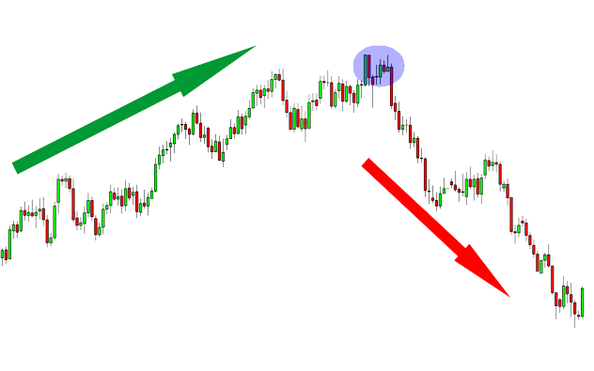
Trend Reversal Indicator
TREND REVERSAL
UPTREND
DOWNTREND
Notes:
Image: https://pixabay.com/illustrations/technology-artificial-intelligence-3762547/

Slide 2
PARAMETERS AT PLAY
Trend Reversal Indicator is built using these Technical parameters….
RSI & BB (Bollinger Bands)
STOCHASTIC OSCILLATOR
Relative Strength Index (RSI) is a momentum oscillator that measures the speed and change of price movements and Bollinger Bands or BB depicts two standard deviations above and below a simple moving average.
It’s a momentum indicator that compares a security's closing price to a range of its prices over a given time period.Compared to RSI, stochastics are more effective in sideways or choppy markets.
EXPONENTIAL MOVING AVERAGE
CANDLESTICK PATTERN
Candlestick pattern is a movement in prices shown graphically on a candlestick chart
An exponential moving average (EMA) is a type of moving average (MA) that places a greater weight and significance on the most recent data points.

Slide 3




10 Months Back Test
Risk to Reward
Substantial Data set
1:2 Risk to Reward Ratio was targeted in Backtests
Results of Backtest were concluded after More than Thousand backtest
Instrument
Accuracy
Backtest was done on BTC-USDT 15 min TF over a period of 10 months
After Rigorous Backtests, Accuracy of Trend Reversal Indicator came out to be around 45-55%

Slide 4
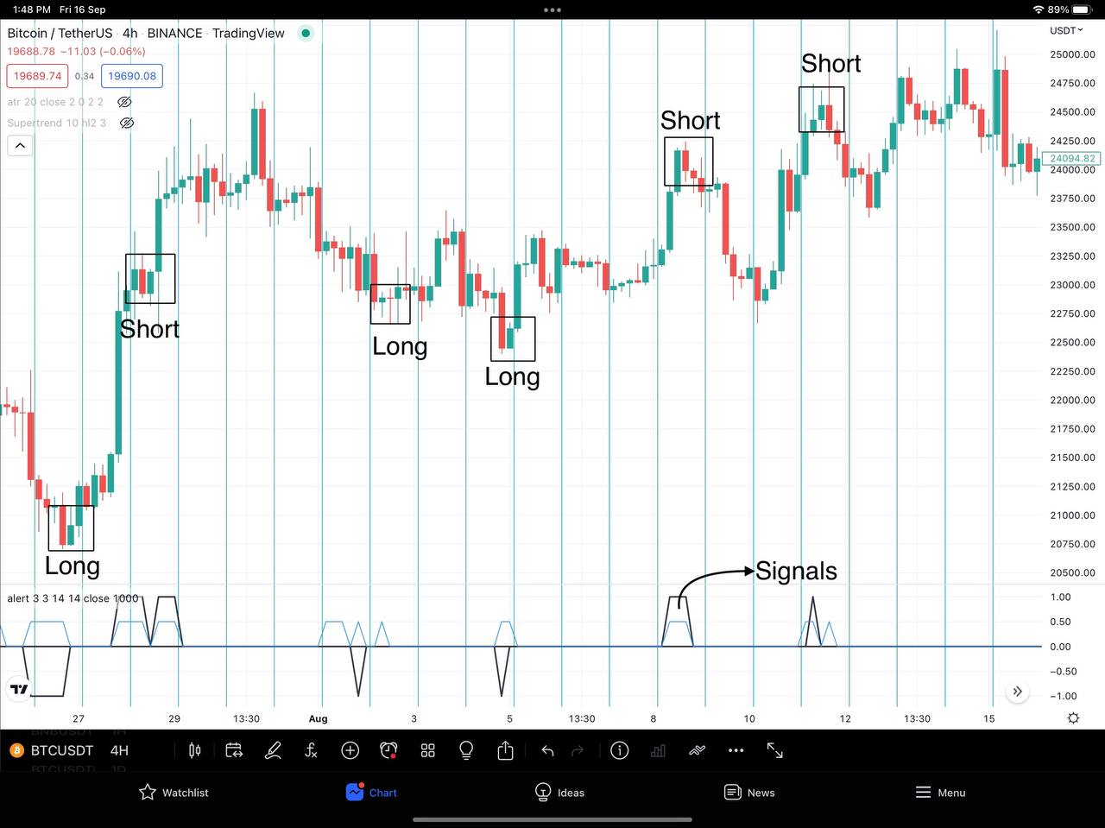
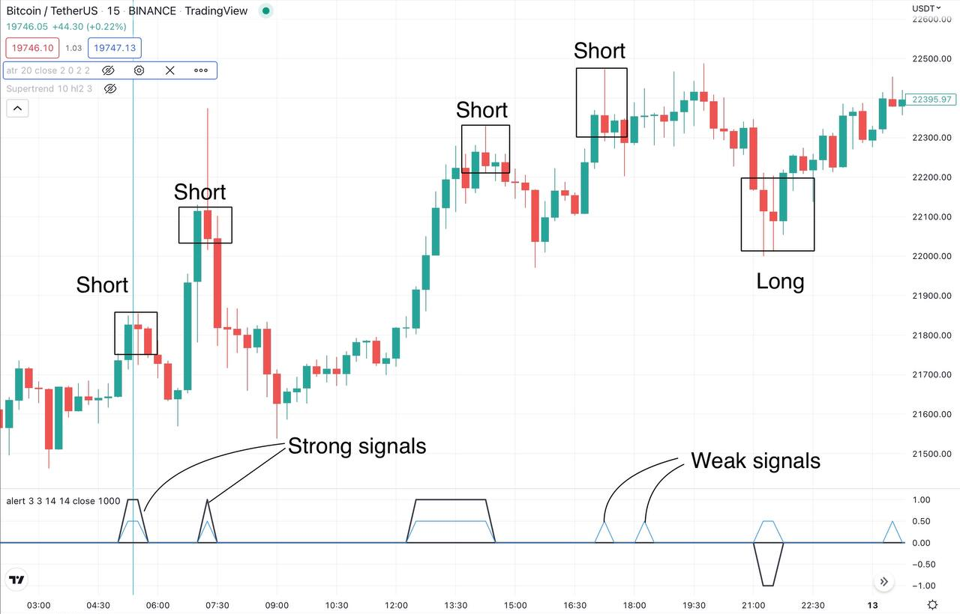
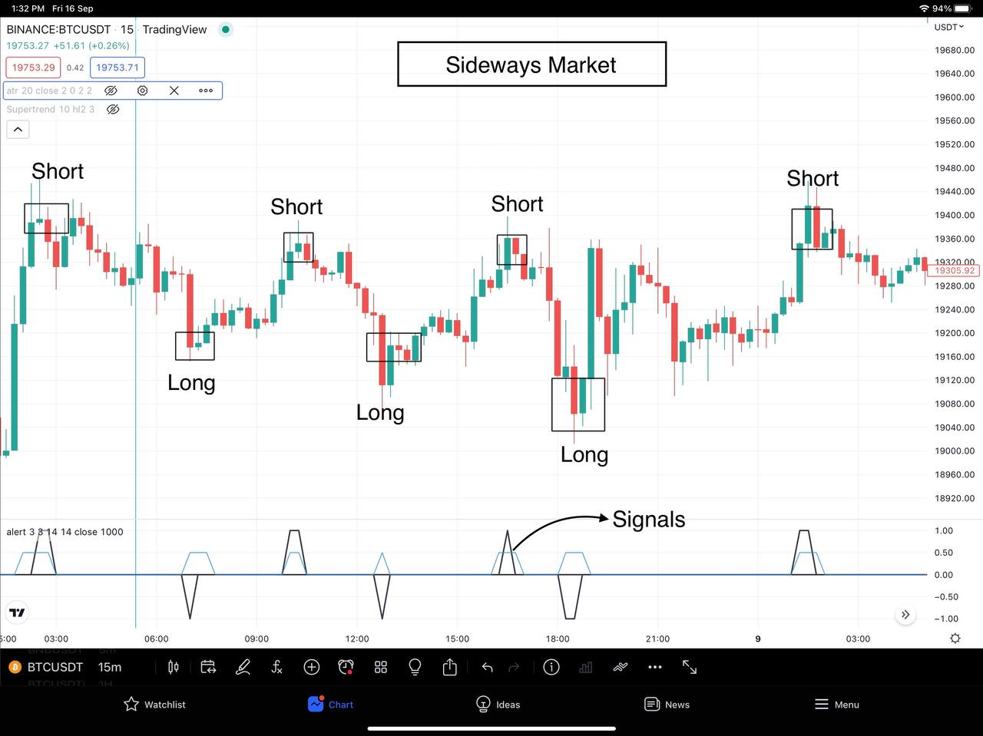
Trend Reversal Indicator In Action

Slide 5
Market Dynamics
Explored and pinpointed different Market dynamics with help of varied instruments and Technical Indicators On Why It Sometimes Under performs (Below 40%) and Sometimes Outperforms (above 70%)

Slide 6
THANK YOU

